Slide 1
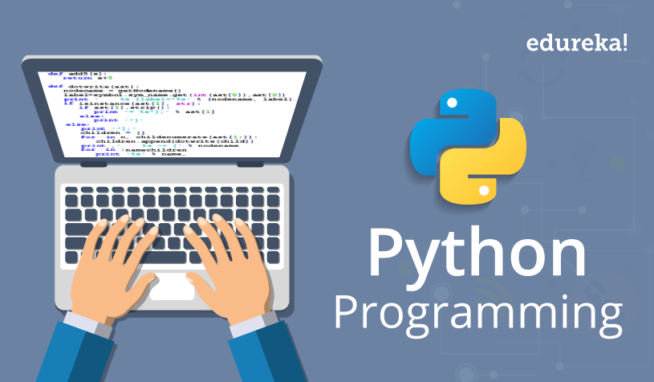


Slide 2

Session1
Programming Languages
Session 2
Variables
Basic Operations
Session 3
Data Structures
Session 4
Session 5
Establishing Python Work Space
Conditionals
Loops
Computer Science

Slide 3
Session 6
Session 7
Session 8
Session 9
Session 10
Working with Files
Functions
Object Oriented Programming
What are libraries
Hands on Automation Projects

Slide 4
Calculator
Sending Emails
File Categorizer
YouTube Downloader
Excel Automation
Currency Convertor

